Slide 1
SI 671 Discussion 4
Introduction to
Mining Sequence Data

Slide 2
What is sequences mining?
Itemset mining (not order) vs. Sequence mining (buy first and next?)
“A topic of data mining concerned with finding statistically relevant patterns between data examples where the values are delivered in a sequence.”
Applications: Bioinformatics (DNA), Spelling correction, NLP (string sequence)

Slide 3
Outline
- Sequence comparison/alignment
- The Levenshtein Distance
- BLAST
- Named Entity Extraction
- HMM
- CRF

Slide 4
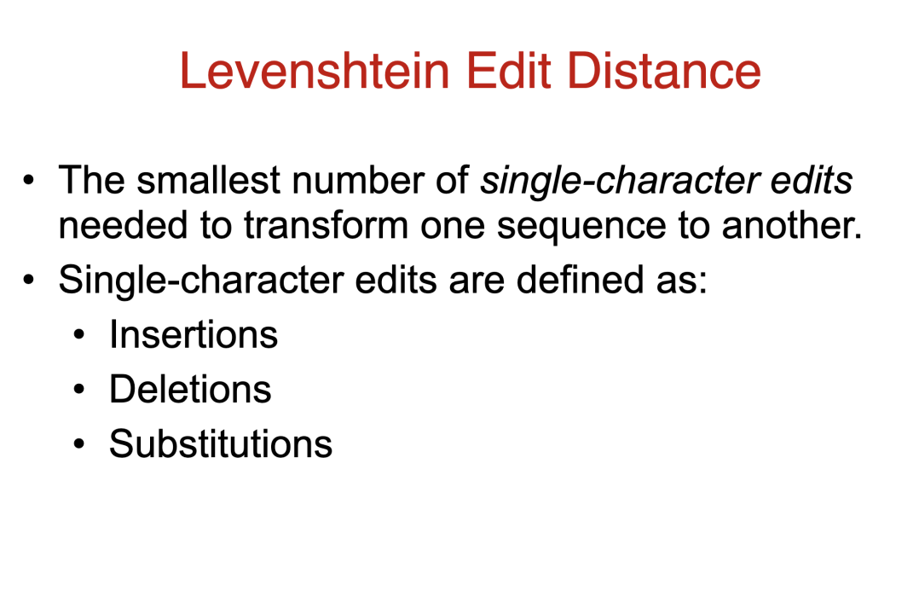

Slide 5
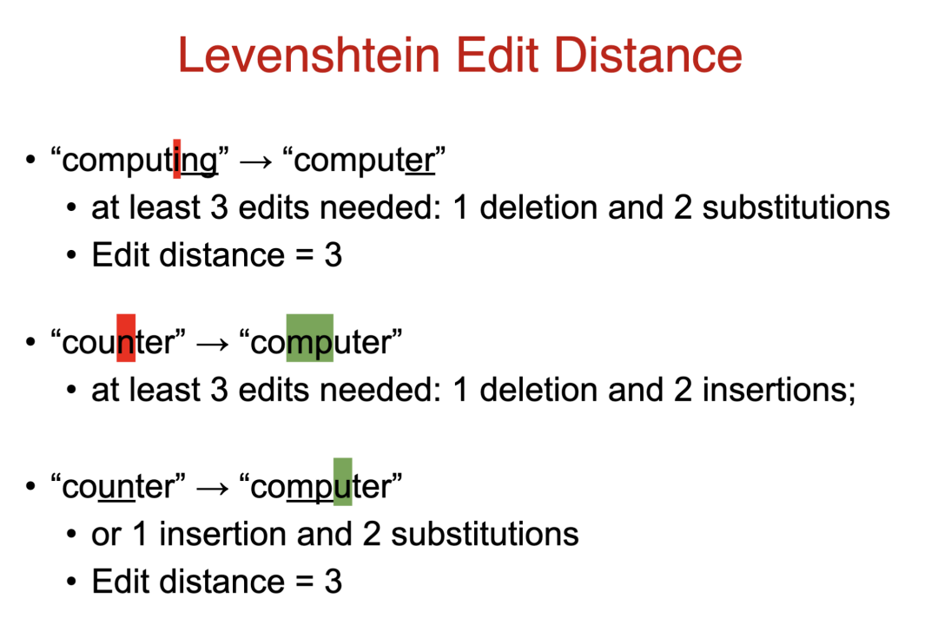

Slide 6
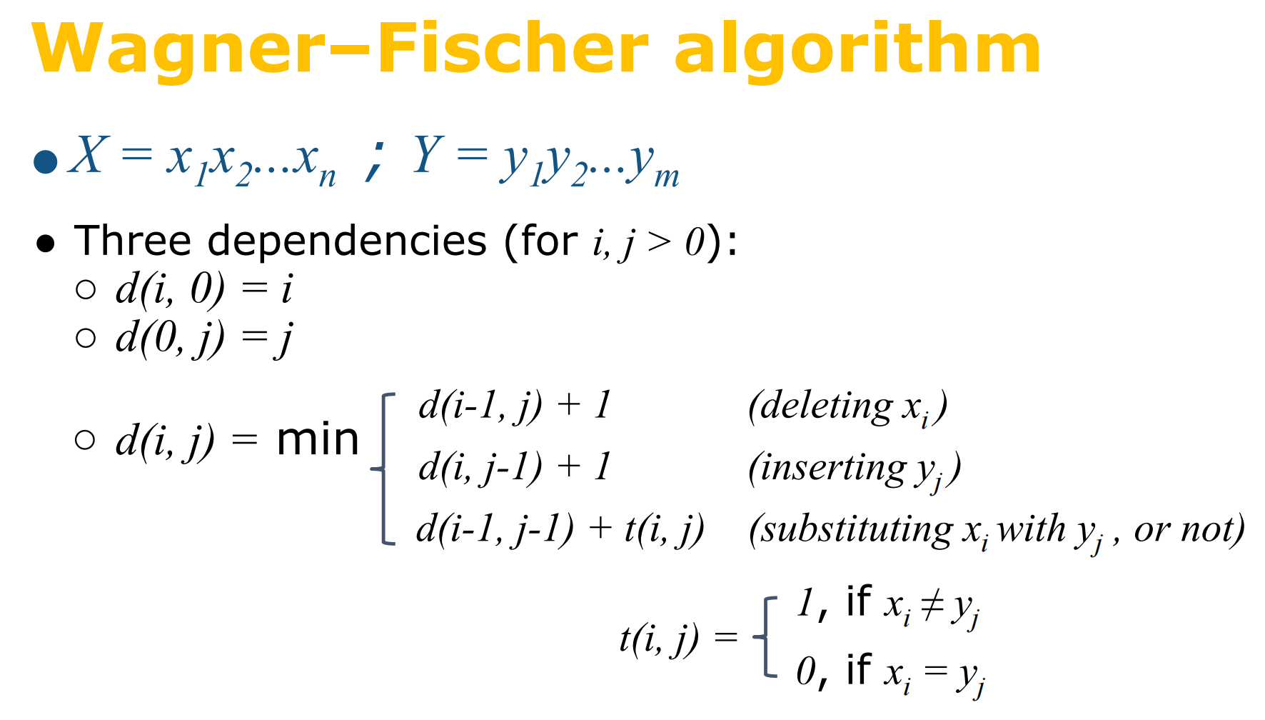

Slide 7
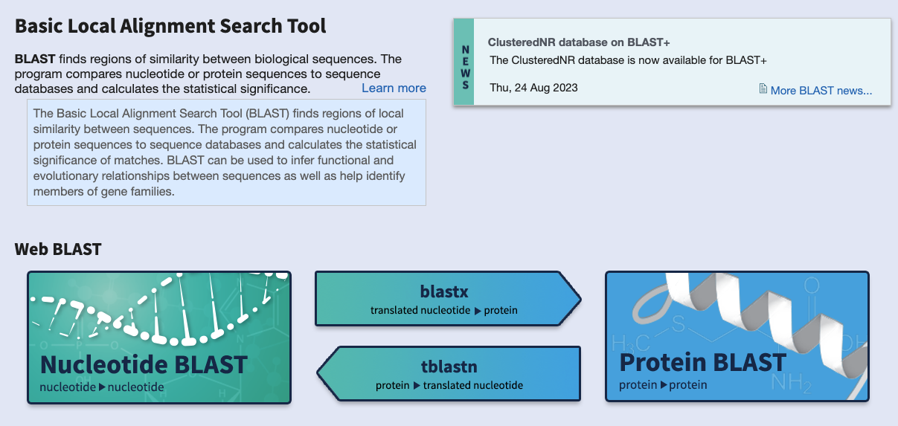
Notes:
Dna sequence

Slide 8
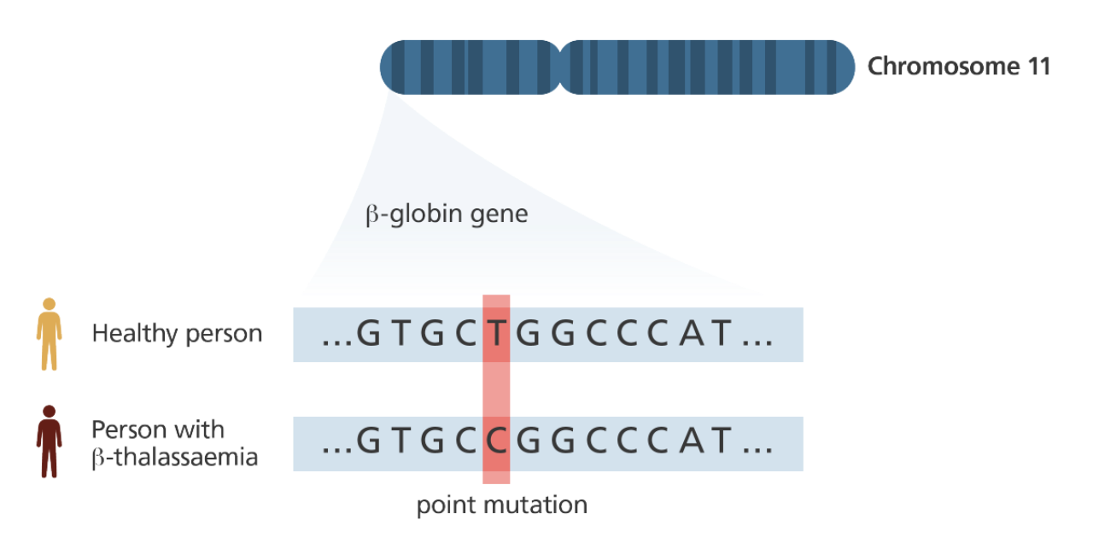
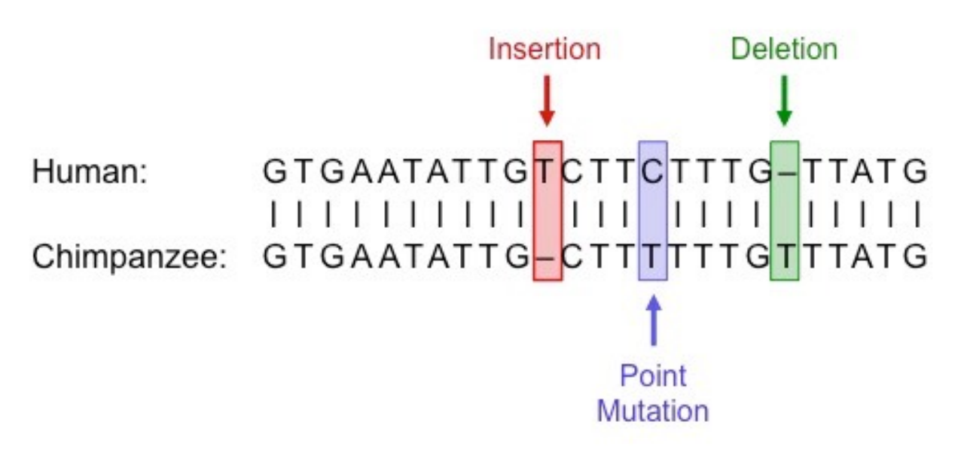
Genome Sequence
Disease
Mutation

Slide 9
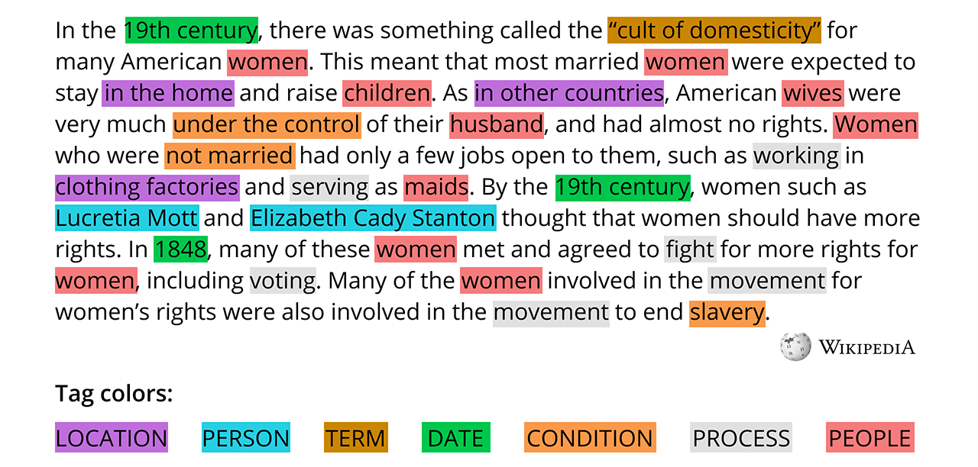
Named Entity Extraction
Named-entity recognition (NER) (also known as (named) entity identification, entity chunking, and entity extraction) is a subtask of information extraction that seeks to locate and classify named entities mentioned in unstructured text into pre-defined categories such as person names, organizations, locations, medical codes, time expressions, quantities, monetary values, percentages, etc.

Slide 10
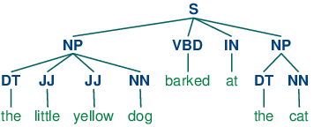
POS Tagging
In corpus linguistics, part-of-speech tagging (POS tagging or PoS tagging or POST), also called grammatical tagging is the process of marking up a word in a text (corpus) as corresponding to a particular part of speech,^{[1]} based on both its definition and its context. A simplified form of this is commonly taught to school-age children, in the identification of words as nouns, verbs, adjectives, adverbs, etc.

Slide 11
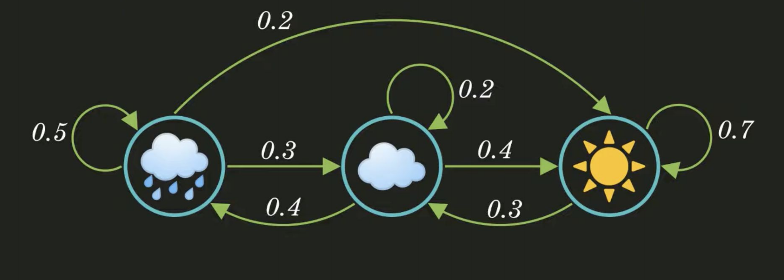
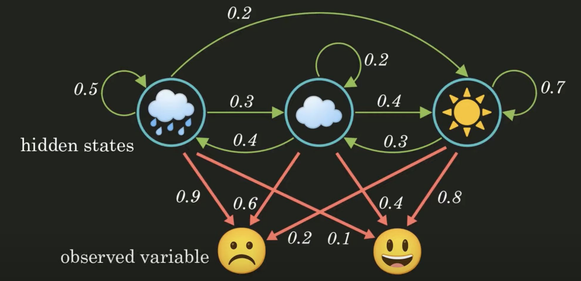
Markov Model → HMM
Notes:
How do you explain your boss's mood changes in one week?

Slide 12
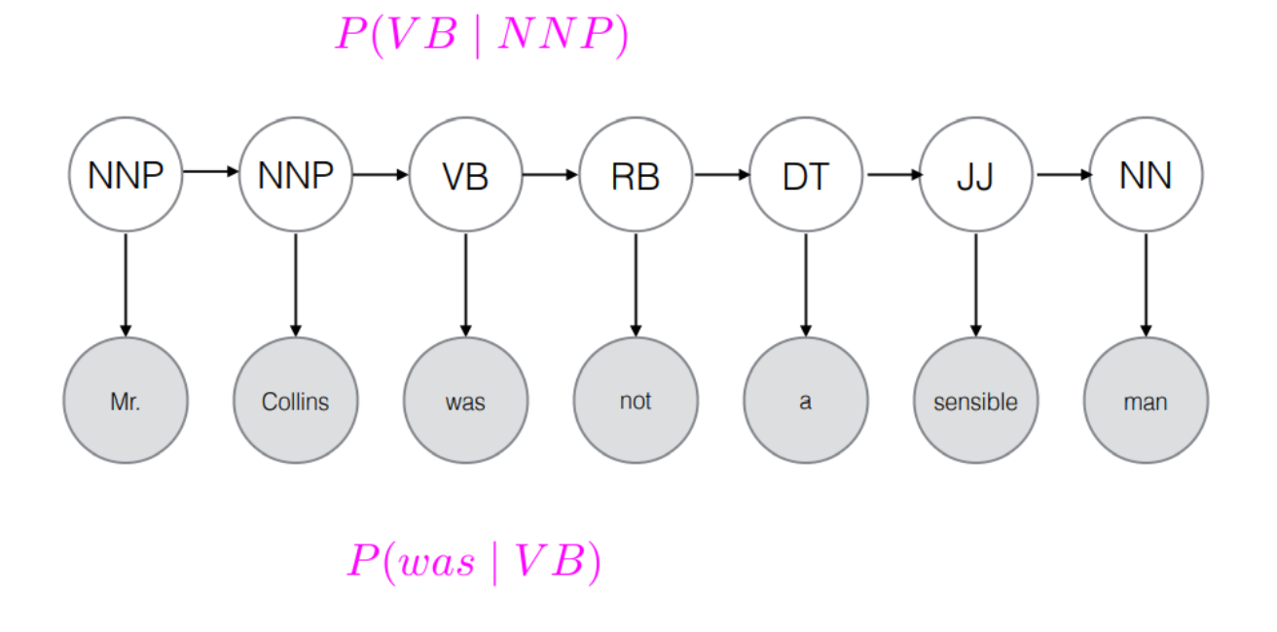
HMM in NLP
Hidden Markov Model: it is a Markov chain as the system state is partially observable. It is commonly used for speech recognition where the observed data is the speech audio waveform and the hidden state is the spoken text. It assumes a first-order Markov assumption.
Markov assumption: it is an assumption made in Bayesian probability theory, that every node in a Bayesian network is conditionally independent of its non-descendants, given its parents.

Slide 13
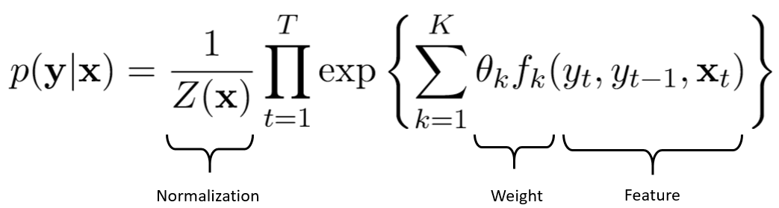
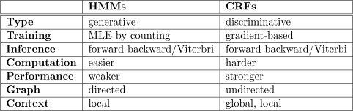
Conditional Random Field
HMMs assume that the probability of a label at a given time step depends only on the previous label in the sequence (Markov assumption). In CRFs, the probability of a label depends on the entire input sequence and not just the preceding label.
HMMs usually assume that the emission probabilities are conditionally independent given the hidden state. CRFs do not make this assumption. CRFs can model dependencies between labels and observations in a more flexible way, allowing for richer modeling of the relationship between observations and labels.
Notes:
https://pages.cs.wisc.edu/~jerryzhu/cs769/CRF.pdf#:~:text=The%20feature%20functions%20are%20the%20key%20components%20of,sequence.%20The%20feature%20functions%20produce%20a%20real%20value.

Slide 14
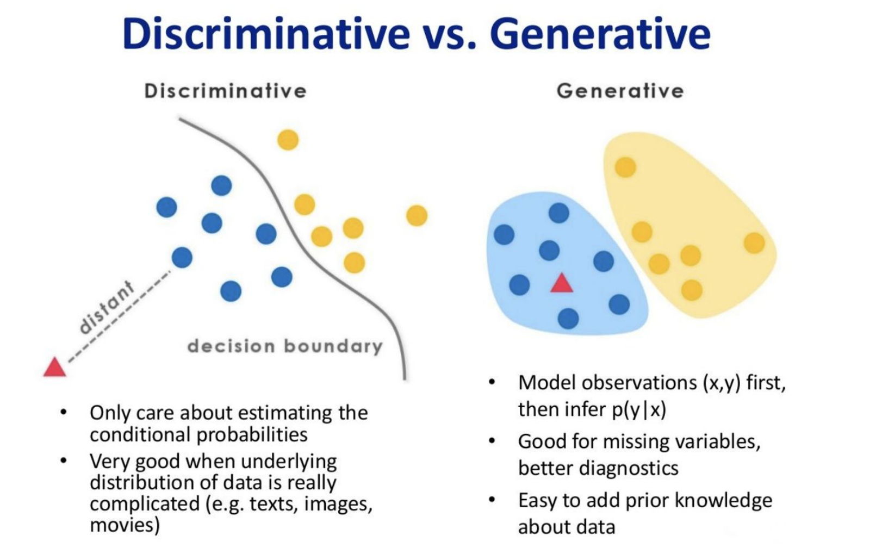

Slide 15
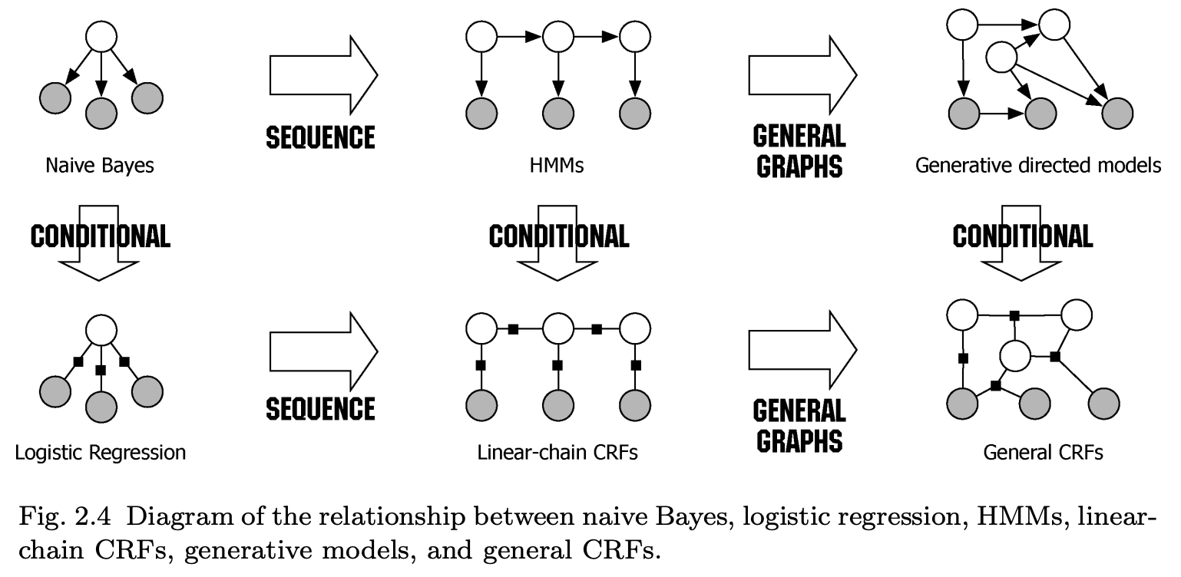
Probabilistic Graphical Models
Notes:
https://www.pure.ed.ac.uk/ws/portalfiles/portal/10482724/crftut_fnt.pdf (P286)

